Slide 1
Regional Community Health Assessment and Improvement Plan
CCO Oregon Annual Conference October 2, 2024

Slide 2
Presentation Panel
Todd Jeter; Behavioral Health Director/Interim Director Social Determinants of Health, Equity, and Transformation; IHN-CCO
Ruby Moon; Community Health Manager; The Confederated Tribes of Siletz Indians
Mica Contreras; Executive Director; Linn Benton Lincoln Health Equity Alliance
Sara Hartstein; Interim Deputy Director of Public Health; Benton County Health Department
Paulina Kaiser; Director Community Health and Research at Samaritan Health Services

Slide 3


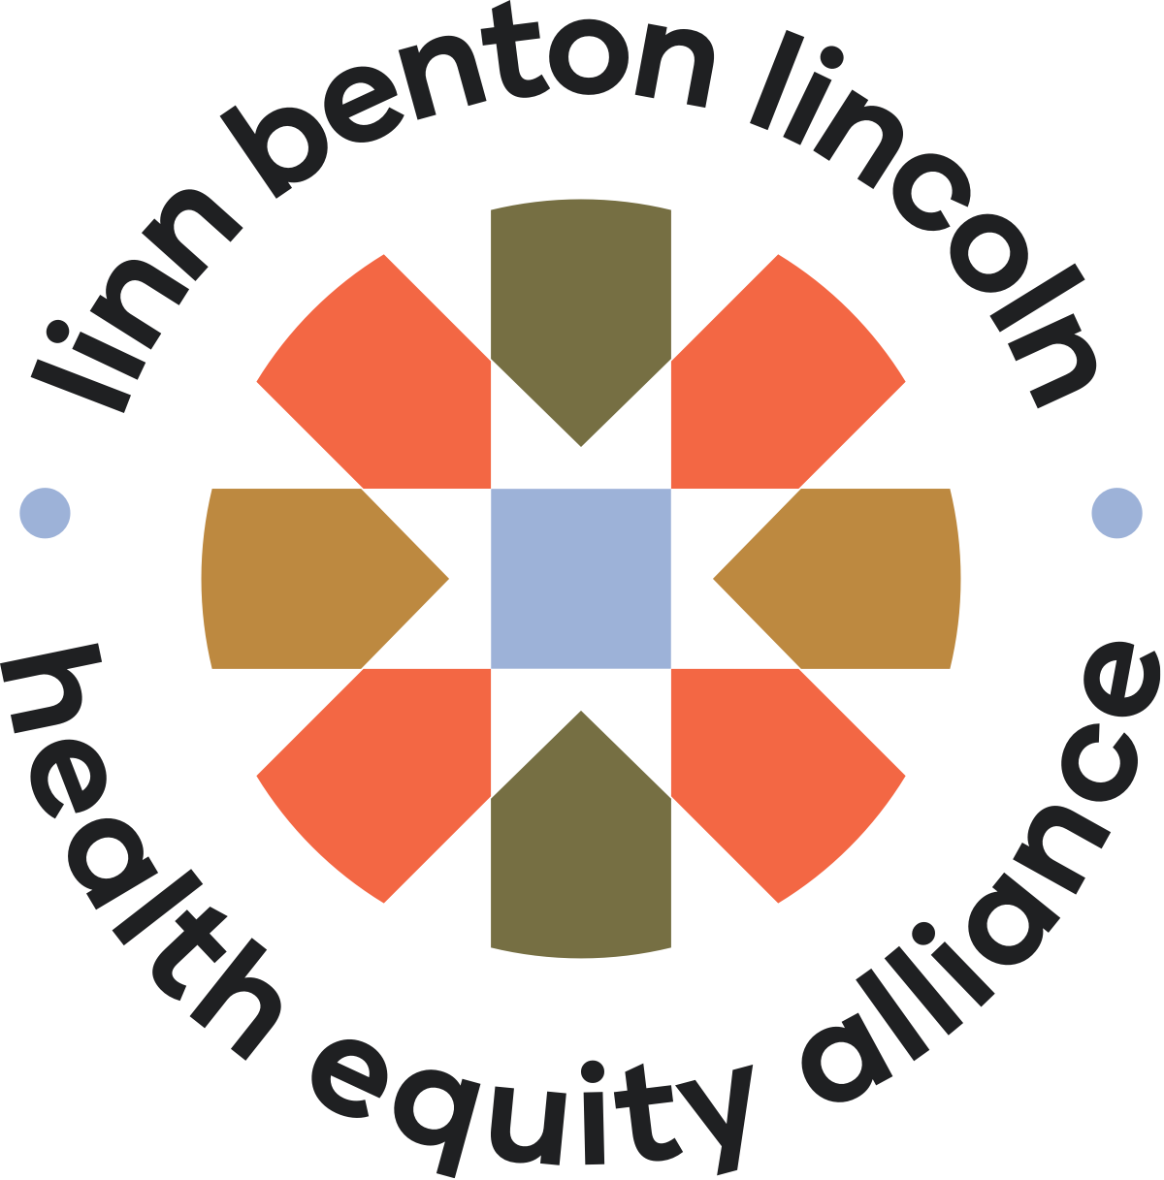







Notes:
The Partnership for Community Health (PCH) is a jointly funded regional collaborative in Linn, Benton, and Lincoln Counties. The PCH is focused on aligning the CCO, hospital system, county public health, tribal partners, and community-based organizations in the development and implementation of a unified Regional Community Health Assessment (RHA) and Regional Community Health Improvement Plan (R-CHIP) that is grounded in equity and elevates the voice of community members. Through meaningful engagement, deep partnership, and collaboration, the PCH has created synergy under a collective impact framework, leveraged compounding resources, and contributed to enriching the interdisciplinary and cross-entity relationships that are the foundation of systemic change.

Slide 4

Timeline
Nov: facilitator contracted
April 2023: RHA published
May: 1.5 FTE staff onboard
Oct: initial gathering of partners for RHA (incl. CDC PHAP)
Sept: ‘Partnership for Community Health’ adopted
Dec-Mar: R-CHIP priority area workgroups
2021
2022
2023
2024
2025
Nov: RHA data workgroup + engagement workgroup convene
Dec: hospital CHNAs finalized
June: launch R-CHIP work
June: R-CHIP published
R-CHA: ~1.5 years
R-CHIP: ~1 year
Notes:
Discuss community engagement components:​
​
Community Health Survey​
Focus Groups​
Key informant interviews​
Listening Sessions​
Workgroup Participation​
Community Advisory Council input, review, and collaboration

Slide 5
Access to Affordable Housing & Homelessness
Key Health Themes from the 2022 - 2026 Regional Health Assessment
Access to Quality Care
Equity, Diversity & Inclusion
Food Insecurity & Access
Healthy Youth & Families
Mental Health
Substance Use and Misuse
Notes:
What is the Regional Health Assessment (RHA)? ​
Information about the region’s health status, needs, and health trends​
Informs plans for community health improvement

Slide 6
Regional Community Health Improvement Plan (R-CHIP)
Each priority area includes a focus on health equity and inclusion, diversity, anti-racism, and equity (IDARE). ​
Health equity means that no individual, group, or people experience worse health outcomes or unequal access to health supports because of factors that are beyond their control or are the result of injustice. Embodying health equity means valuing everyone equally. Achieving health equity requires taking action to prevent inequalities, address injustice, and eliminate health disparities. ​
Inclusion means creating spaces where all people are valued and empowered. ​
Diversity celebrates human differences. ​
Anti-racism actively confronts and transforms systems of oppression and discrimination based on race. ​
Equity addresses systemic barriers and provides access to opportunities and resources.
Notes:
Also discuss regional focus AND priority populations:
The regional CHIP focuses on the priority populations defined in the Oregon State Health Improvement Plan (SHIP) and specific populations highlighted in community conversations.
Priority Populations:
Black people, Indigenous people, people of color and American Indian/Alaska Native people (BIPOC-AI/AN)
People with low incomes
People who identify as LGBTQ+
People with disabilities
People living in rural areas
Individuals experiencing barriers to accessing housing—such as discrimination, history of felony convictions, eviction, and bankruptcy
Individuals experiencing barriers to accessing shelter—including non-binary, gender diverse, neurodiverse, couples, and families
Families with children

Slide 7




R-CHIP Priority Areas
Access to Affordable Housing
Access to Quality Care
Behavioral Health
Inclusion, Diversity, Anti-Racism, and Equity (IDARE)

Slide 8
Goal/Strategy Development Process
Each of the 4 priority areas was assigned:​
Facilitators/Co-leads (2 people): Workgroup leads with priority area expertise who facilitate the brainstorming conversations and the planning team’s review of meetings and notes. ​
Planning Team Members (5-15 people): Subject matter experts and facilitators who met to create agendas, review workgroup materials, and draft goals and strategies based on brainstormed discussions. ​
Workgroup Members (~30-40 people): The community partner organization representatives, individuals with lived experience, and equity experts were invited to participate in goal and strategy crafting. Participants were led through brainstorm discussions for goals and strategies. Participants also reviewed drafted goals and strategies and moved toward finalization.​
Objective: define goals & strategies (focused on collective impact)​
For each priority area → 3 goals​
For each goal → 3 strategies​

Slide 9
Priority Area Goals
Housing | Access to Quality Care | Behavioral Health | IDARE
H1. Expand housing units H2. Expand supportive services H3. Improve housing data | AQC1. Grow and sustain workforce AQC2. Increase OHP access and use AQC3. Timely, local, and empowering care | BH1. Build community resilience BH2. Grow a healthy workforce BH3. Improve care coordination | IDARE1. Improve equity and well-being IDARE2. Increase education and accountability IDARE3. Improve data quality
Notes:
Three goals and three strategies per goal were created for each priority area. Goals are long-term outcomes that set the direction for addressing the key health issues. The regional CHIP built on the goals of Oregon’s 2020–2024 State Health Improvement Plan (SHIP). Strategies are activities performed to reach a goal. All goals and strategies were developed with a focus on priority populations and inclusion, diversity, anti-racism, and equity (IDARE).​
​
Logic models visually display the progress measures and outcomes for each priority area. Progress measures for the regional CHIP are data points that provide information about the status of health outcomes or things that impact health. These data points include both qualitative (narrative) and quantitative (statistical) measures. ​
​
The Progress Measures Team will connect with other data experts from regional counties, the tribes, and coordinated care organizations (CCOs) to focus and refine the measures and outcomes. ​
The Implementation Team is tasked with achieving the goals and strategies. ​
​

Slide 10
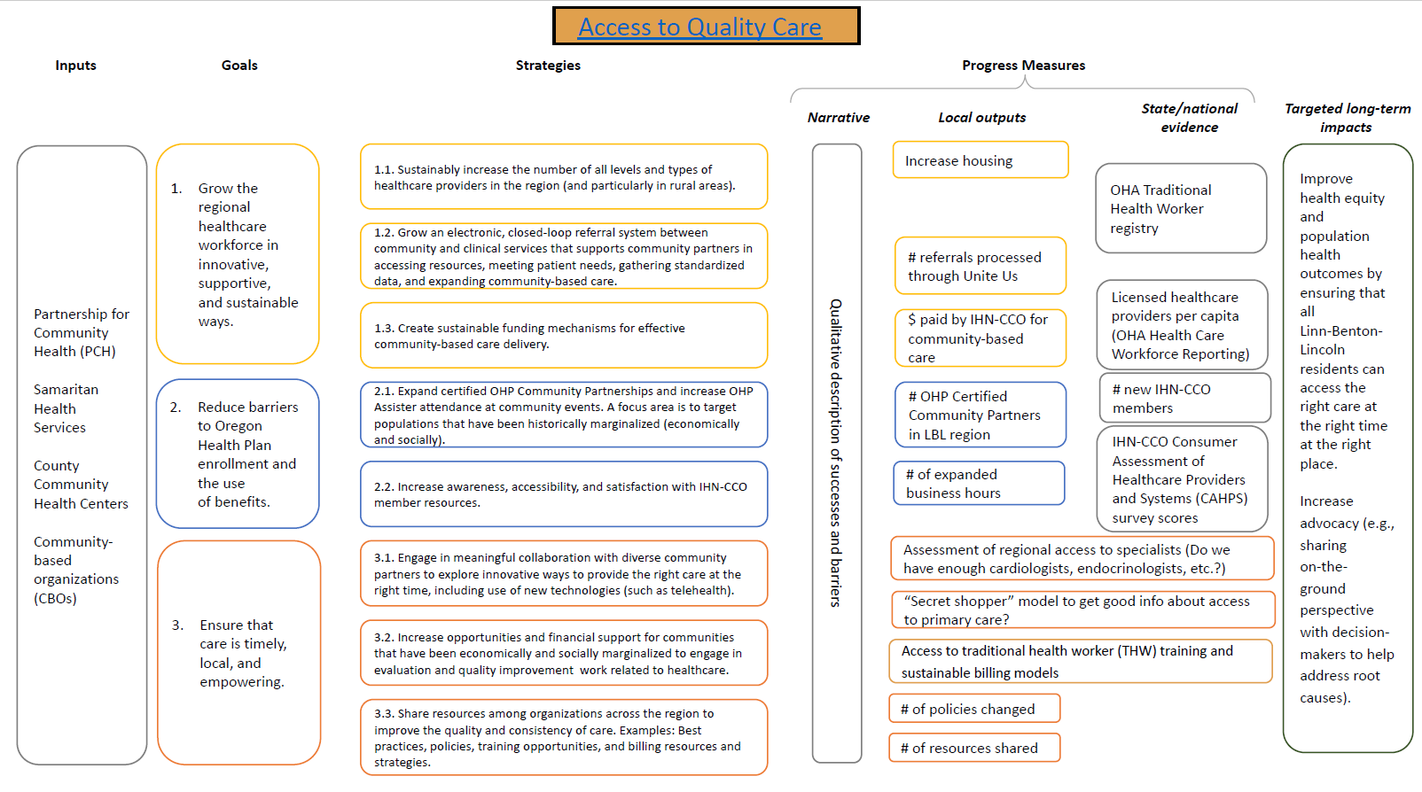

Slide 11
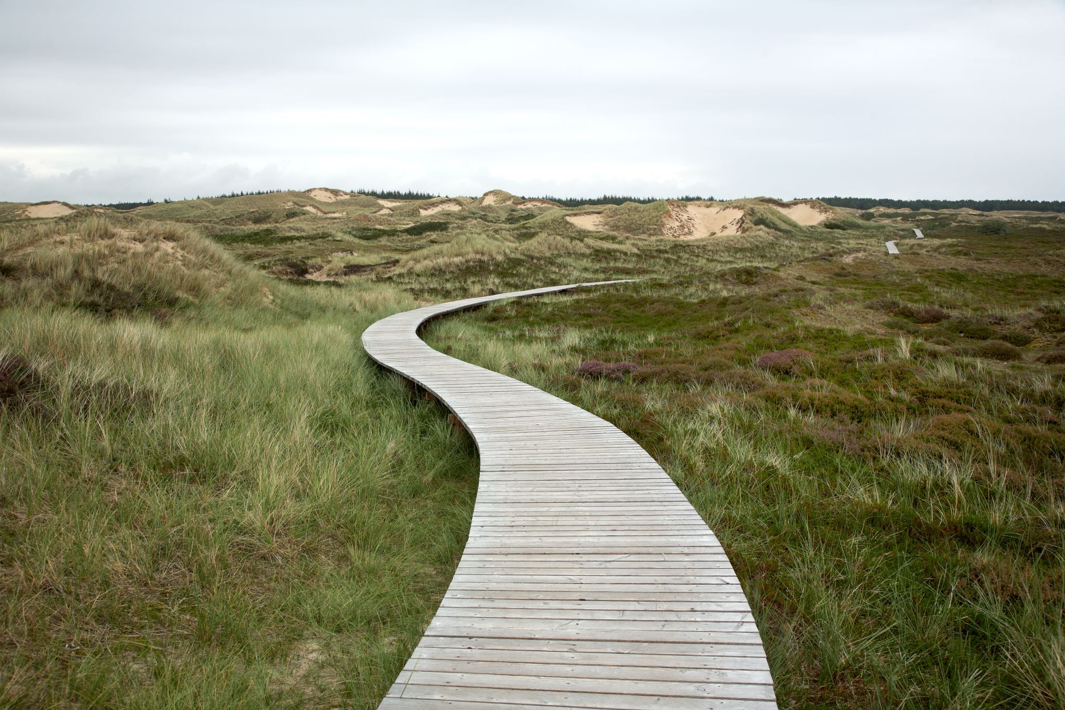
Next Steps
Notes:
Implementation phase

Slide 12

Barriers, Success, and Lessons Learned
Notes:
Provide specific examples

Slide 13

Collaborating Partners
Notes:
Provide specific examples of barriers/successes/lessons learned​

Slide 14
Affordable Housing Partners of Lincoln County
Alsea Community Action Collaborative
Arcoíiris Cultural
Atonement Lutheran Church
Behavioral Health Strategy Committee
Benton County Behavioral Health
Benton County Coordinated Homeless Response Office
Benton County Health Navigation
Benton County Housing
People & Equity (HOPE)
Benton County Public Health Harm Reduction
Building Blocks for Mental Health
Casa Latinos Unidos
Communities Helping Addicts Negotiate Change Effectively (C.H.A.N.C.E.), Behavioral Health Resource Network member (BHRN)
Community Crossroads
Community Health Centers of Benton and Linn Counties
Community Services Consortium
Child Development Network
Corvallis Multicultural Literacy Center
Coast to the Cascades Wellness Network
Community Harm Reduction Mentors & Allies (CHRMA)
College of Osteopathic Medicine of the Pacific-Northwest (COMP-NW)
Community Outreach, Inc. (COI)

Slide 15
Conexión Fénix Confederated Tribes of Siletz Indians (CTSI) Corvallis Daytime Drop-in Center Exodus Recovery Faith Community Health Network Faith Hope & Charity* Family Tree Relief Nursery* (BHRN) Farmworker Housing Development Corporations Growing Ancestral Roots Integrated Services Network Support Services Intercommunity Health Network Coordinated Care Organization (IHN-CCO) International Moms Group Lincoln County Behavioral Health Lincoln County Community Health Center Lincoln County Housing Authority Lincoln County Public Health Linn Benton Hispanic Advisory Council Linn Benton NAACP Linn County Multi-Agency Collaborative GroupitAC Group Linn County Public Health Mid Willamette Trans Support Network (MWTSN) Northwest Coastal Housing

Slide 16
Oregon Public Health Association Old Mill Center for Families & Children Oregon Coast Bank Oregon State University College of Health Oregon State University Student Health Services ReConnections Counseling Regional Health Education Hub Roundhouse Foundation Samaritan Family Medicine Samaritan Health Services (SHS) Samaritan Treatment & Recovery Services (STARS)s South Benton Food Pantry Strengthening Rural Families Systems of Care United Way of Linn, Benton &, and Lincoln Counties Unity Shelter Young Roots Oregon

Slide 17

Questions?

