Slide 1
Keeping the Member in “Member Centric”
CCO Oregon Conference Panel Presentation
October 2, 2024
Alexa Jett, BSDH, EPDH, CareOregon
Kerrin Swanson, CPNP-PC, Adventist Health
Erin Oldenkamp, CPNP-PC, Adventist Health
Kyle Geelan, DMD, Wallace Medical Concern
Lisa Bozzetti, DDS, Virginia Garcia Memorial Health Center

Slide 2
The CareOregon Family
CareOregon is a mission-driven, community based nonprofit organization. For 30 years, CareOregon has offered health services and community benefit programs to Oregon Health Plan members.
Today, we support the needs of over 500,000 Oregonians through three coordinated care organizations, a Medicare Advantage plan, a Tribal Care Coordination program, a dental care organization, and in-home medical care, palliative care and hospice with Housecall Providers.
CareOregon members have access to integrated medical, dental and mental health care and substance use treatment. We also connect members to housing, fresh food, education and transportation services.
17,603
37,611
1,950
66,214
15,622
442,123
116,992
*** Membership numbers updated as of July 1, 2024

Slide 3
Integration:
a key element of health care transformation
Bidirectional integrated service delivery systems
Managing competing priorities and benefit plans
Improving access to care, reducing barriers
Keeping the focus on whole person health

Slide 4
the right care, at the right place, at the right time

Slide 5
Partnerships and innovations
Adventist Health
  Fluoride varnish, dental education and referral in primary care
Wallace Medical Concern
  Immunizations, A1C services in dental
Virginia Garcia Memorial Health Center
  Maximizing impact with the new Dental Therapist role

Slide 6

Pediatric preventive care
Adventist Health
Erin Oldenkamp, CPNP-PC
Certified Pediatric Nurse Practitioner Primary Care and Pediatric Mental Health Specialist
oldenkew@ah.org
Kerrin Swanson, CPNP-PC
Certified Pediatric Nurse Practitioner Primary Care
swansokd@ah.org
Oral health service delivery in primary care

Slide 7
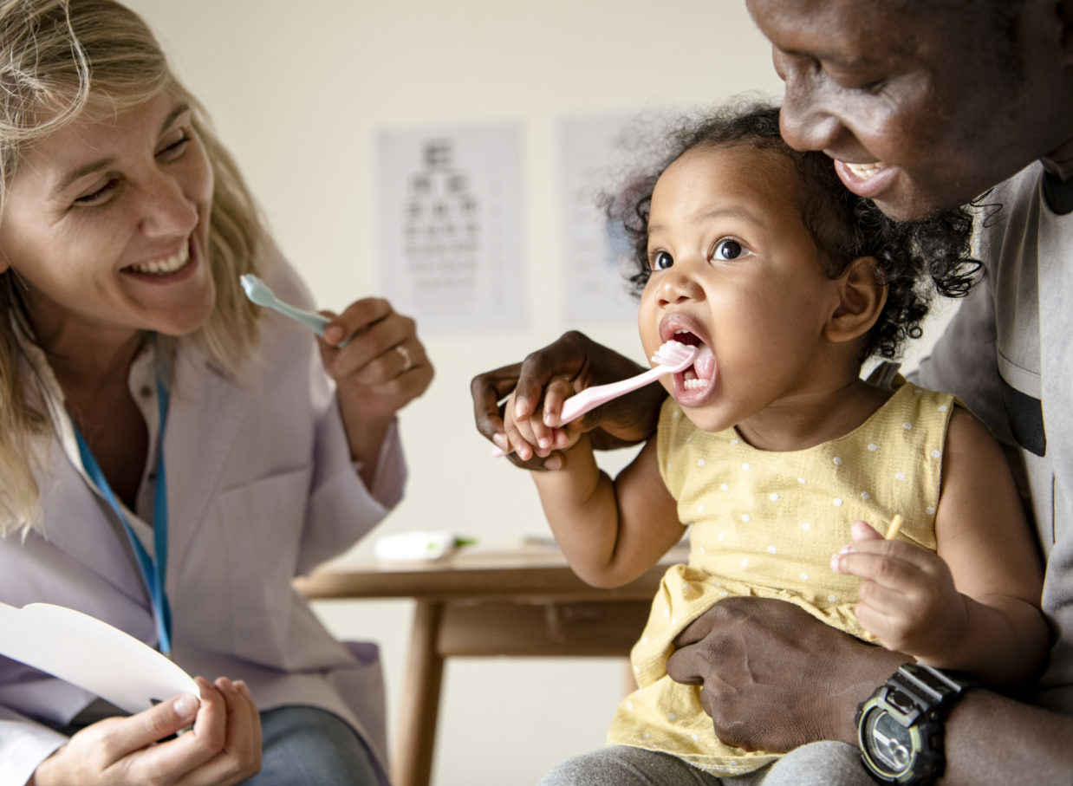
Ingrained Habits: Current State
Cultural Shift: Oral health has become part of our organizational culture.
Embedded Practices: Oral health services have been woven into our everyday practices, becoming second nature.
Sustainable Integration: What once felt like a novel concept is now a sustainable part of our operations, enhancing overall healthcare outcomes.
Community Acceptance: Our community has embraced integrated oral health services as standard practice, reflecting its success and impact.

Slide 8
Pediatric Oral Health Services
2018 through 2023 Adventist provided a total of:
2,233 fluoride applications
2,726 oral assessments

Slide 9
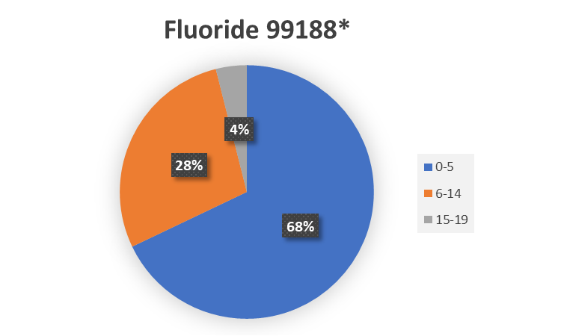
Pediatric Oral Health Services
2018 through 2023 Unique Fluoride Applications by age group: 1,511 fluoride applications*
44
384
1083
*Unique members: patient only counted once per year​

Slide 10

Envisioning the Future:
Process and Quality Improvement
Continuous Improvement: While oral health services has become second nature, we continue to refine and improve our approaches to better serve our patients.
Upskilling new MAs and staff on processes due to staff turnover.
Create process to monitor and track dental referral outcomes once CPCCO dental care request dashboard is launched.
Continued collaboration on the unique and specific challenges faced by rural communities in accessing dental services.

Slide 11

Primary Care services in Dental
Wallace Medical Concern
Kyle Geelan, DMD
Lead Dentist / Head of Dental Innovations
Kyleg@mywallace.org
Immunizations, A1C services
& care coordination between
Primary Care and Dental

Slide 12

The Wallace Evolution
Added Dental in 2016
"Co-located"
Re-co-located 2020
Set the stage

Slide 13
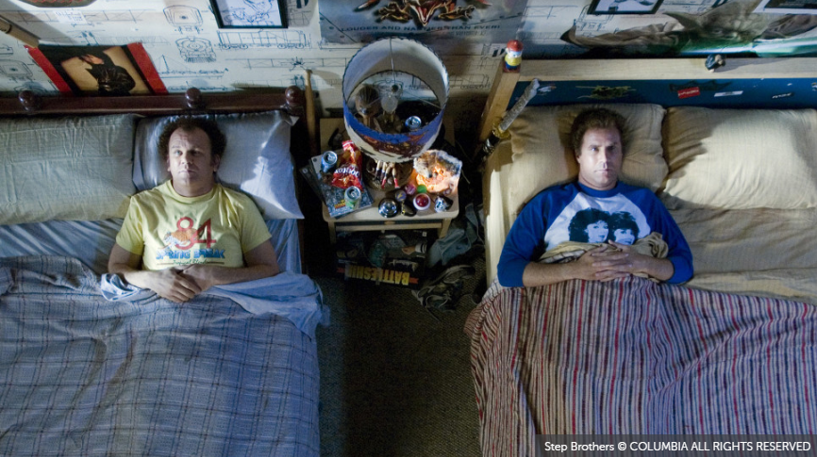
Natural consequences
What happened
Consolidated reception
Shared huddles
Unification

Slide 14
Meeting patients where they are
Opportunities to provide services
Started with Diabetic labs
Expanded to vaccinations
Full scope panel management

Slide 15

Progress

Slide 16

“Progress is not an illusion; it happens, but it is slow and invariably disappointing.”
- George Orwell
https://www.blinkist.com/magazine/posts/progress-quotes-keep-motivated?utm_source=cpp

Slide 17

Embedded model of care
Virginia Garcia Memorial Health Center
Lisa Bozzetti, DDS
Dental Director
lbozzetti@vgmhc.org
Maximizing impact with the new Dental Therapist provider role

Slide 18
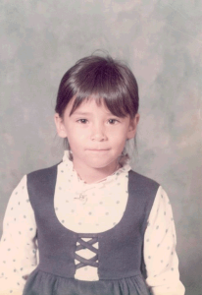
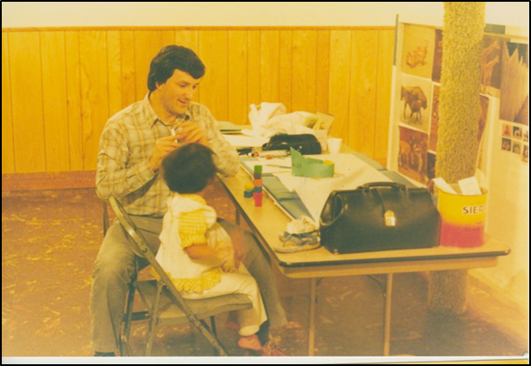
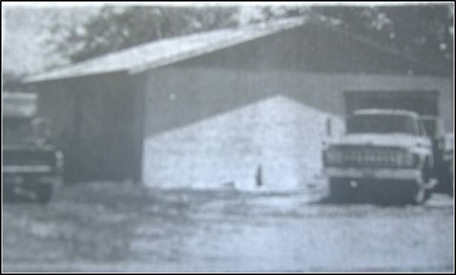
Virginia Garcia Memorial Health Center
Virginia Garcia
1969 - 1975

Slide 19
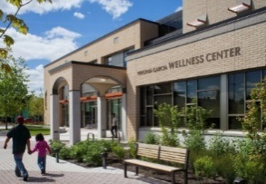
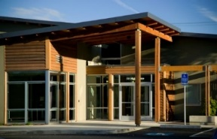

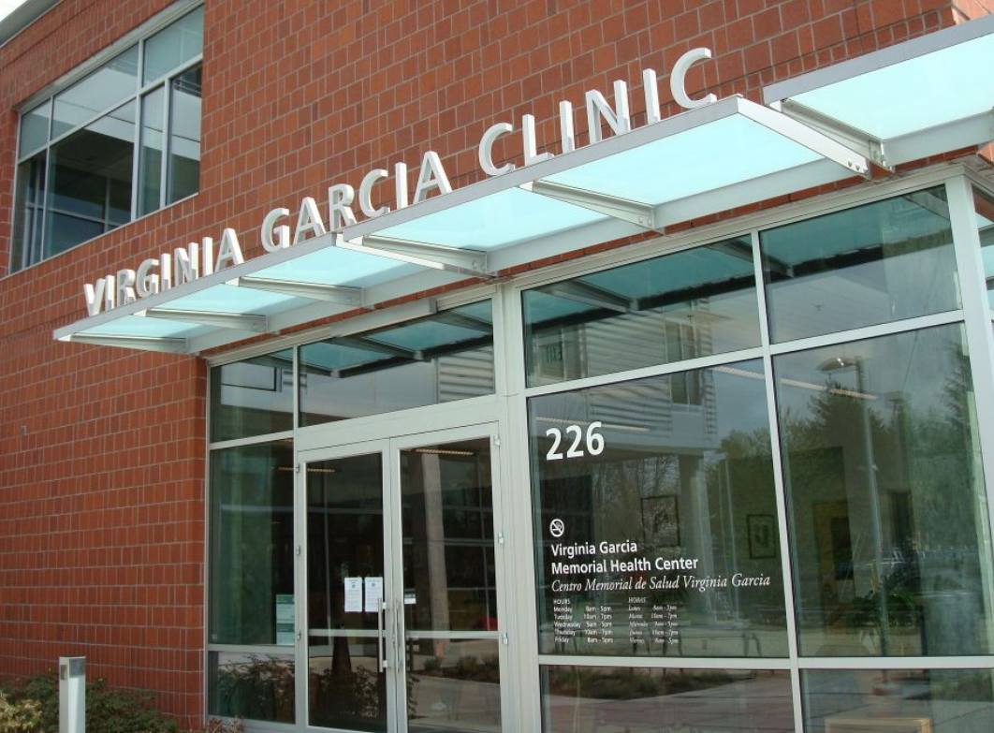
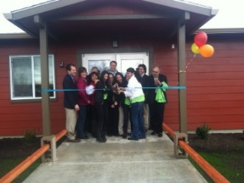
Our Health Center
We serve more than 50,000 patients in Washington and Yamhill counties:
  Six primary care clinics with pharmacies and behavioral health services in Newberg, McMinnville, Beaverton, Hillsboro, Cornelius and Willamina
  Six dental clinics in Newberg, McMinnville, Beaverton (2), Hillsboro and Cornelius
  Five school-based health centers located in Tigard, Hillsboro (Century), Beaverton, Forest Grove and Willamina and operate a school sealant program
  A Reproductive Health Clinic
  Three Mobile Outreach Clinics
  A centralized administration building
  Today we serve 1 in every 14 residents in the 2 counties we serve

Slide 20
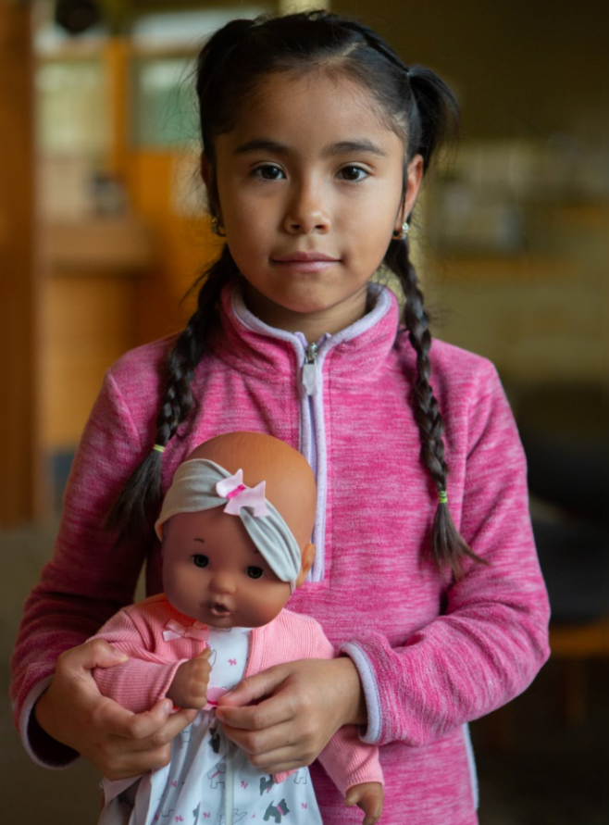
Our Mission & Vision
Virginia Garcia is a catalyst for change in health care delivery.
The Mission of the Virginia Garcia Memorial Health Center is to provide high quality, comprehensive, and culturally appropriate primary health care to the communities of Washington and Yamhill counties with a special emphasis on migrant and seasonal farmworkers and others with barriers to receiving health care.
Our vision is simple. We work to ensure that all people in our service area have access to timely, high-quality health services, enabling them to achieve the best possible health outcome.

Slide 21
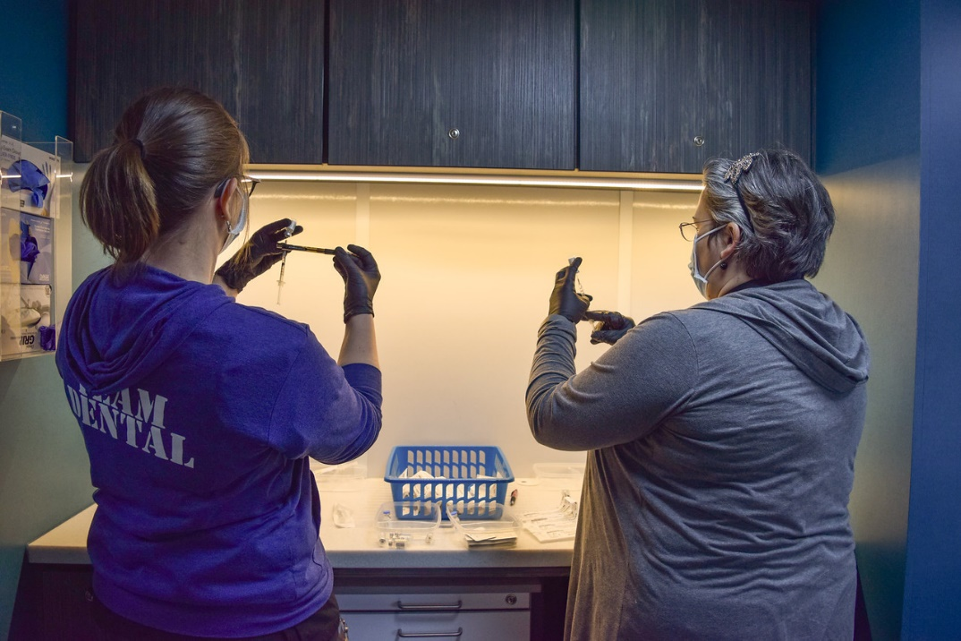
Medical Dental Integration Key Elements
Co-location
Electronic Health Record (EHR)
  HL7 interface
  Same EHR for all departments
The “right” people doing the work
Continuous Change Management
Readiness of Teams
  Engaged and supportive leadership
  Workflows
  Engaged clinical teams

Slide 22
Addressing Care Gaps through a shared EHR
Dental Teams can be a part of informing our patients of overdue preventive needs:
Vaccines *
A1cs *
Breast cancer screening
Cervical cancer screening
Colorectal cancer screening
Depression screening *
SBIRT *
* Dental Team can provide with appropriate training
Medical Teams can inform patients if they are overdue for:
Dental exam
Periodontal probing
Dental cleaning
Dental x-rays
Fluoride varnish *
*Medical team can provide with appropriate training

Slide 23
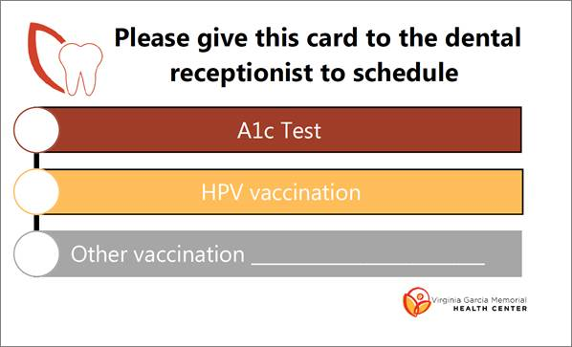
MMR / DPT

Slide 24
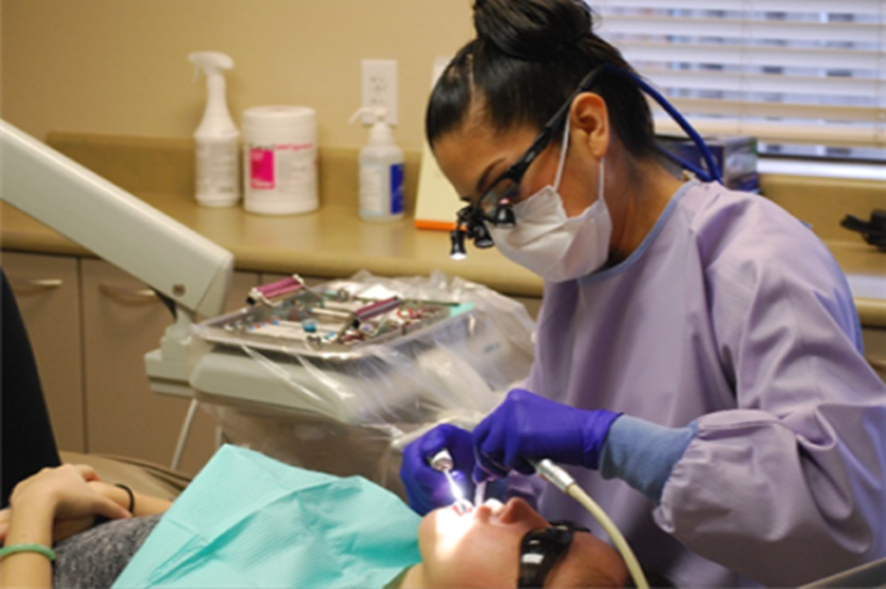
Hygienists' role in Medical Dental Integration
Unique roles for Dental Hygienists:
  Embedded in primary care clinics *
  Embedded in pediatric or OB clinic *
  Embedded in ICUs / hospitals *
  Combined skillset with Dental Therapy
  Provider in SBHC
*Requires hygienist to work in a collaborative agreement with a dentist

Slide 25
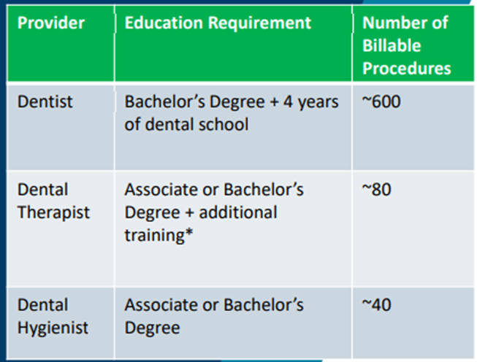
What is a Dental Therapist?
Primary oral health professionals
  Provide critical routine and preventive services under the supervision of a dentist.
Provide a narrow set of commonly needed procedures
  Thus, they can be trained in far less time and at far less cost than a dentist
Accessible education = more likely to be from the communities they serve
Costs of employing a dental therapist are about 1/3 to 1/2 that of a dentist
An affordable way to treat more low-income and uninsured patients

Slide 26
Integration Strategy: Dental Therapy
Meeting patient dental needs in primary care
Increased access for Priority Populations
Strengthened liaison with primary care
Barriers
  Unfamiliarity with respective workflows
  Size of clinic / buy-in from teams
Wins
  SOP for pregnant patients to receive dental services
  Increased collaboration across departments
What’s next?
  Solidify roles
  Productivity ramp up

Slide 27
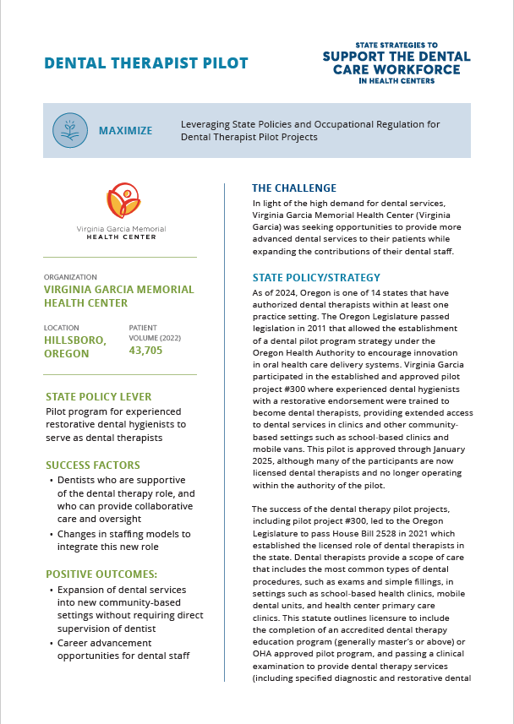
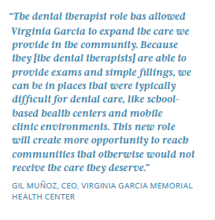
Funded by the CareQuest Foundation for Oral Health
NACHC Shining Star Publication

Slide 28

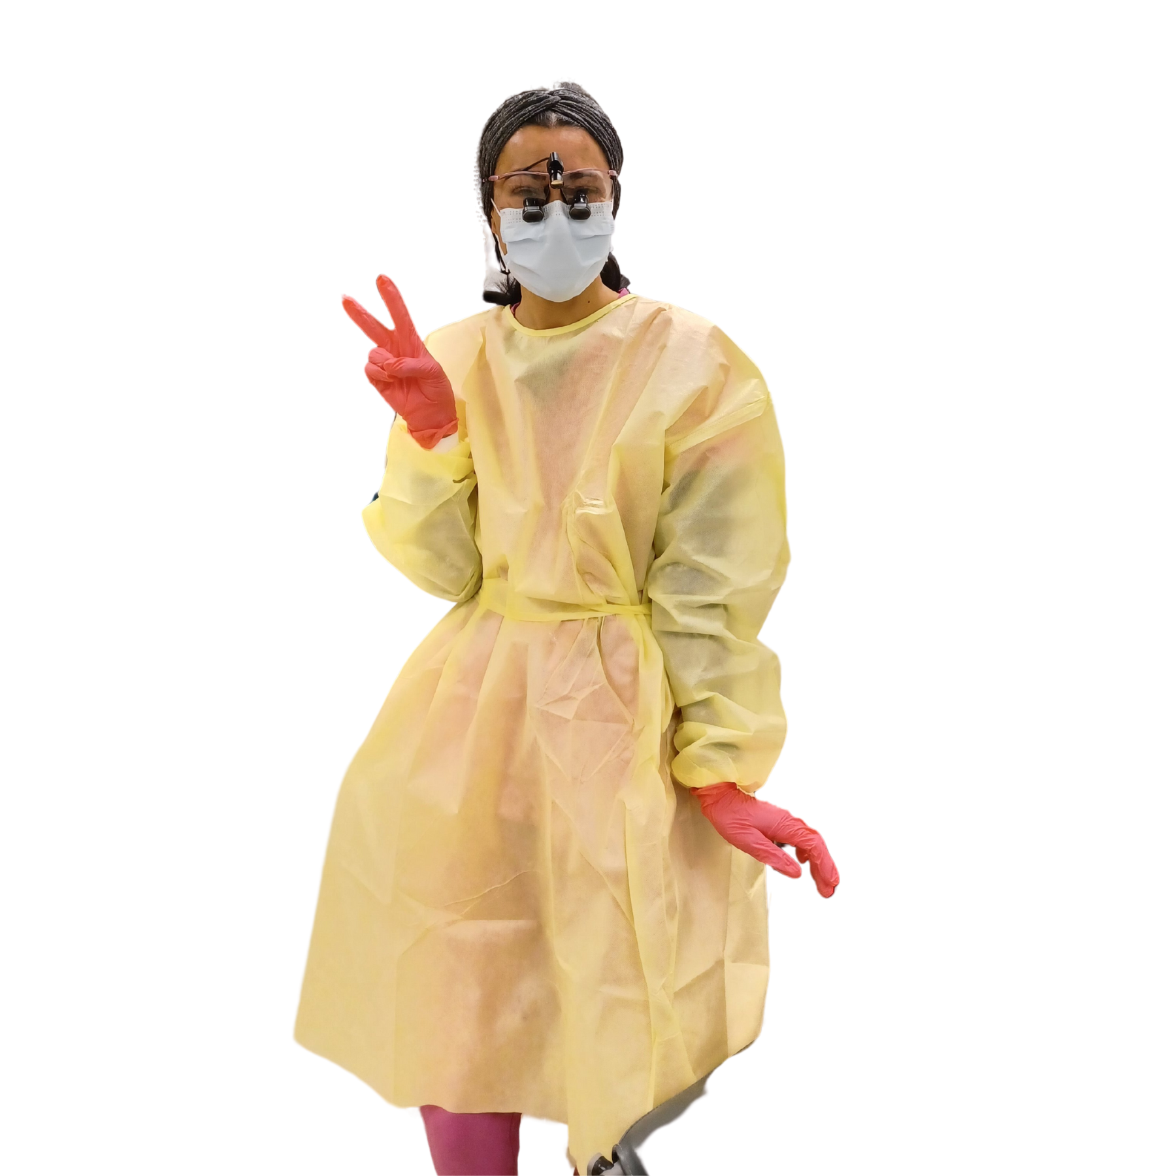



Thank You
Lisa Bozzetti DDS
Dental Director
Virginia Garcia Memorial Health Center
lbozzetti@vgmhc.org
@VGMHC
@ClinicaVirginiaGarcia (Spanish-only page)
@VGMHC
Virginia Garcia Memorial Health Center and Foundation
Virginia Garcia Memorial Health Center

Slide 29

Panel Q & A session

Slide 30
Thank you!
Alexa Jett, EPDH, Director of Oral Health Clinical Services
jetta@careoregon.org

