Slide 1





Early learnings from the use of Community Information Exchange (CIE) for implementation of the Health-Related Social Needs (HRSN) Medicaid Waiver Benefit
CCO Oregon Conference
October 2, 2024
Notes:
LIZ

Slide 2
Panelists
Maureen Seferovich, LCSW (she/her)
Program Manager- Health Systems Integration
Health Share of Oregon
Leslie Neugebauer OTR/L, MPH (she/her)
Vice President of Community Health, Social Needs, and Health Equity
PacificSource
Cara Kangas, CRS-DC (she/her)
Director of Partnerships
211info
Jennifer Gustafson (she/her)
Director, Community Engagement
AllCare Health
Liz Whitworth, MPH (she/her)
Managing Director
Oregon Health Leadership Council (OHLC)
Notes:
LIZ to introduce panelists

Slide 3

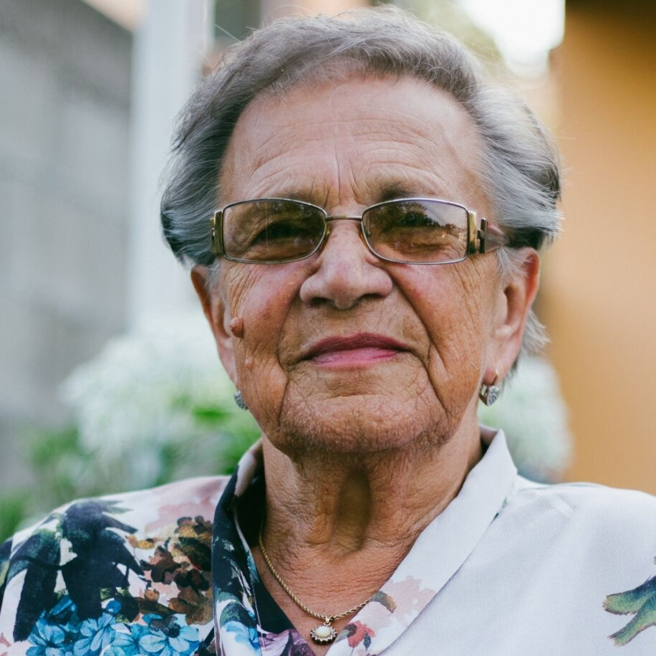
What is Connect Oregon?
Connect Oregon connects health care and social service providers to deliver integrated whole person care through a shared technology platform. Through Unite Us, partners can:
Make electronic referrals
Securely share client information
Track outcomes together
Inform community-wide discussion
Connect Oregon is available Statewide and provided at no cost to all community-based organizations, community health centers, and healthcare providers contracted with our CCO and health system partners.
Notes:
LIZ: very brief reminder of what Connect Oregon is

Slide 4














Clatsop
Columbia
Morrow
Umatilla
Wallowa
Tillamook
Washington
Multnomah
Sherman
Gilliam
Union
Hood River
Wasco
Yamhill
Clackamas
Marion
Lincoln
Polk
Wheeler
Grant
Baker
Benton
Linn
Jefferson
Available in all 36 counties
Crook
Malheur
Lane
Deschutes
Douglas
Harney
Coos
Klamath
Lake
Curry
Jackson
Josephine
Notes:
LIZ: Very brief recap of map

Slide 5
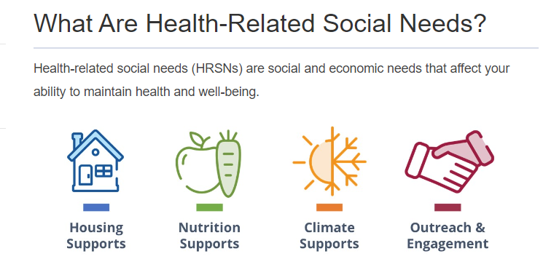
Implementing the HRSN Benefit using CIE
Things we did in similar ways
Things we did differently
Things we learned so far
Where we go from here
Q&A
Notes:
LIZ to set up panel discussion items

Slide 6
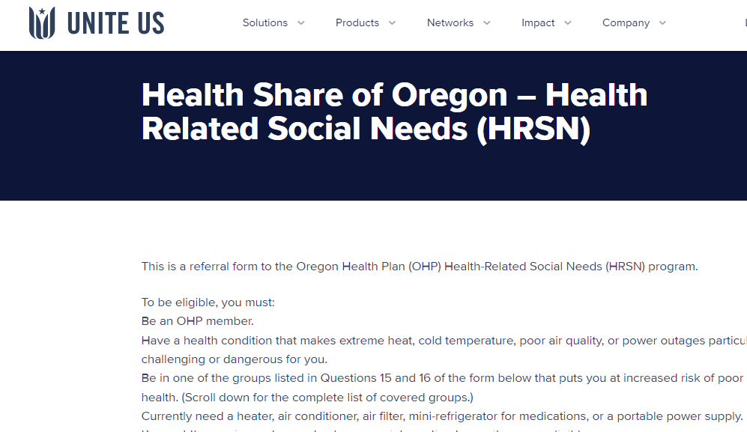
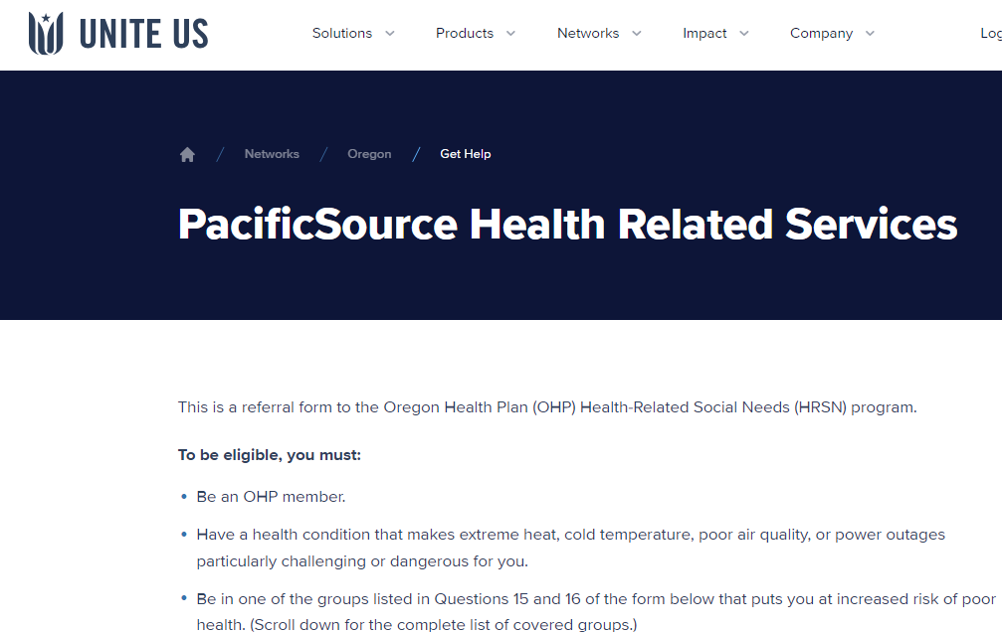
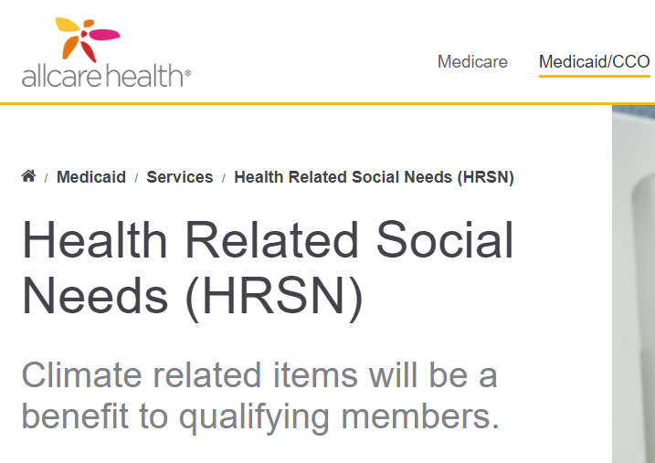
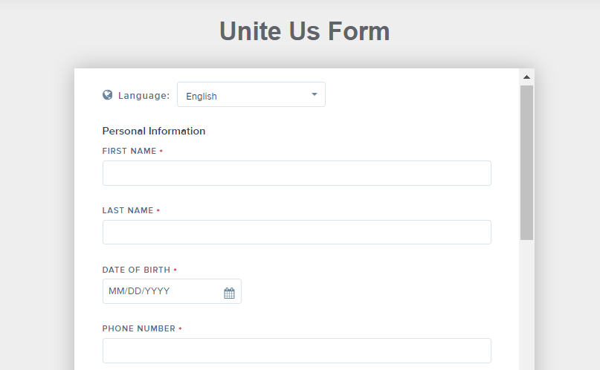
Things we did in similar ways
Encouraged adoption of Connect Oregon among CBOs to gain experience with sending & receiving closed-loop referrals
Made use of client self-referral pathways (aka “Assistance Request Forms”) to support no-wrong-door approach to HRSN Requests
Notes:
LIZ very brief recap of bullets Leslie: Recap of member-self referral volume (~95% of all HRSN Requests) coming in from this approach.
Maureen: HS also posted member self-referral form which drop directly into Unite Us for 211info to pick up and process--more on partnership with 211info later. Jennifer: AllCare posted same form but embedded on AllCare website—so looks a bit different but same questions and drops right into Unite Us platform for AllCare staff to pick up.

Slide 7
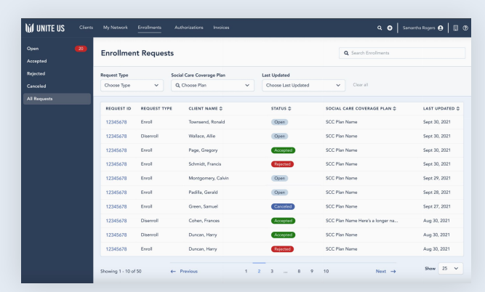
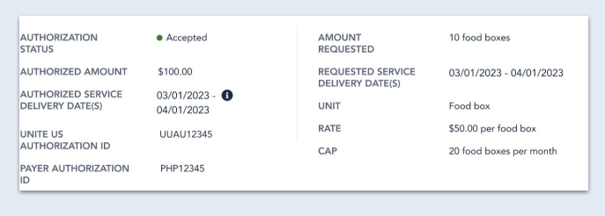
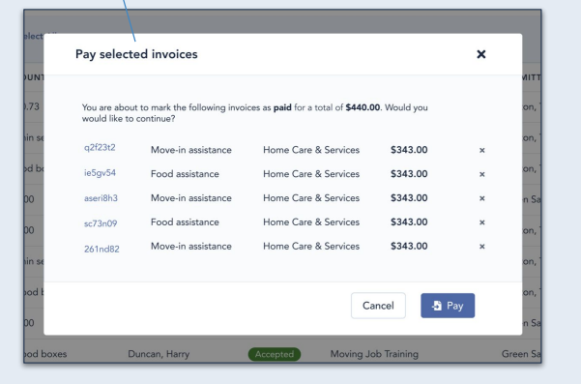
Things we did differently
Leveraged Unite Us “Payments” functionality for HRSN eligibility
Flexibility to implement one or multiple modules for referrals, approvals, service authorization, invoicing, claims, & data reporting
11 CCOs are in various stages of Payments implementation based on their preferred approach
Notes:
LIZ: quick set up
Leslie: PS using end to end solutions/all modules across all PS CCOs. Claims recently went live! Maureen: HS offered all Payments modules to HS Partners. Adoption varies by domain. KPNW and OHSU Health using Payments for Climate. CareOregon will use all modules for Housing, serving as the Central Authorizing Entity for all HS members for the Housing Benefit. Nutrition TBD.

Slide 8
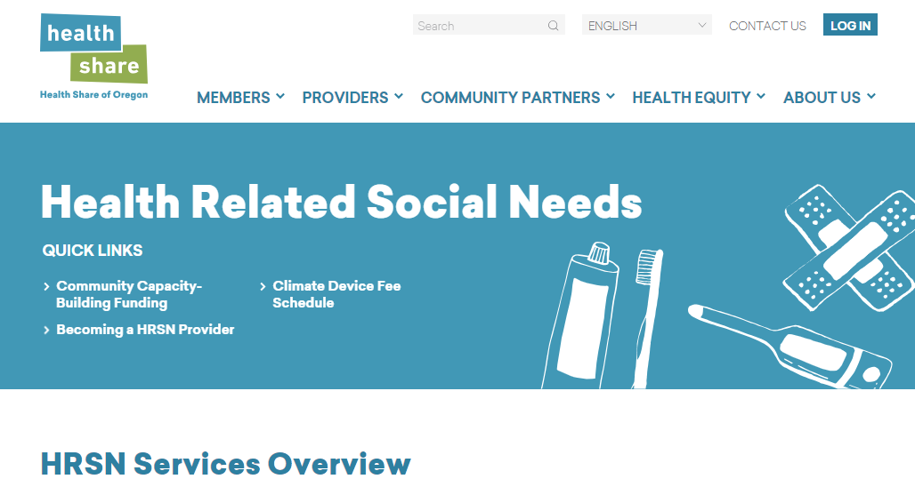
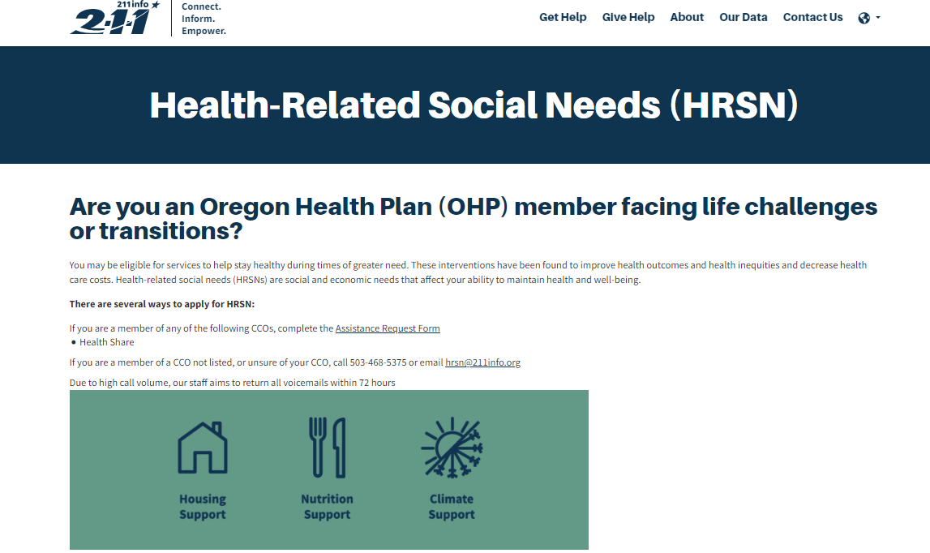
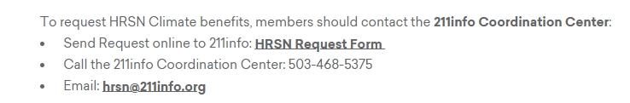
Things we did differently
Implemented a “Front Door” approach to HRSN requests in partnership with 211info
Notes:
Maureen: HS contracted with 211info to serve as a “Front Door” entity to manage incoming HRSN request in a variety of formats and help achieve that “no wrong door” approach.
Cara: To speak on various ways 211info processing HRSN Request (within UU, email, fax, phone, text). Can also speak to experience of Coordination Center on UU past few years and now standing up a HRSN CC team to work with CCOs across all HRSN domains.

Slide 9
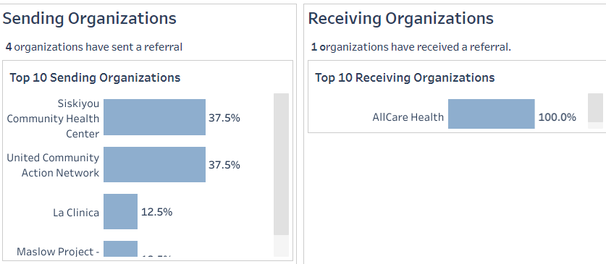
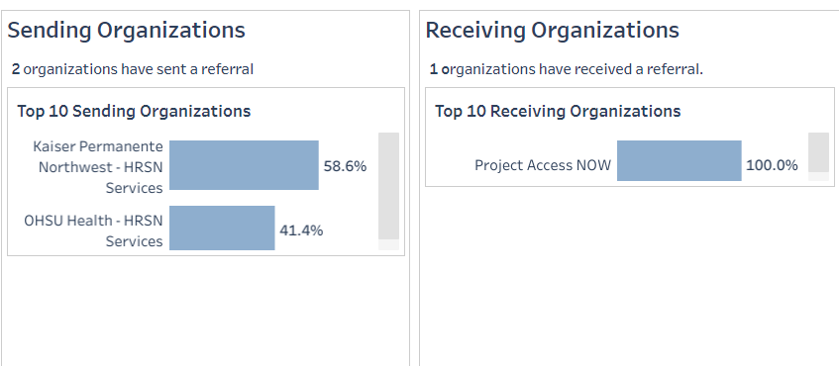
Things we did differently
CBO to CCO for Climate Device Fulfillment
Fulfilled Climate Requests In House or via CBO partners
CCO/IDS Plan to CBO for Climate Device Fulfillment
Notes:
Liz quick set up:
Jennifer: AllCare started a pilot with a small # of CBOs to send referrals to AllCare for Climate requests and fulfillment. Has been successful so far for all partners involved—both CBOs and AllCare team.
Maureen: KPNW and OHSU Health sending authorized referrals to Project Access NOW for Climate Devices. Have learned a lot and all partners work together in Office Hours to track progress, troubleshoot, and improve workflows.

Slide 10

Things we learned so far
“CIE+” functionality is needed to implement HRSN. More than just closed-loop referrals.
Peer-to-peer learning & alignment on workflows helps
Members can use self-service tools to seek out HRSN services
Climate was a useful practice run but approaches to Housing & Nutrition will be very different
Significant staff time to implement & optimize workflows in a very dynamic environment
Continuous training on Connect Oregon is essential and helps with other CCO priorities
Notes:
LIZ: (We’ll leave up these points for audience to review and will go down line of panelists for any comments they want make!)

Slide 11
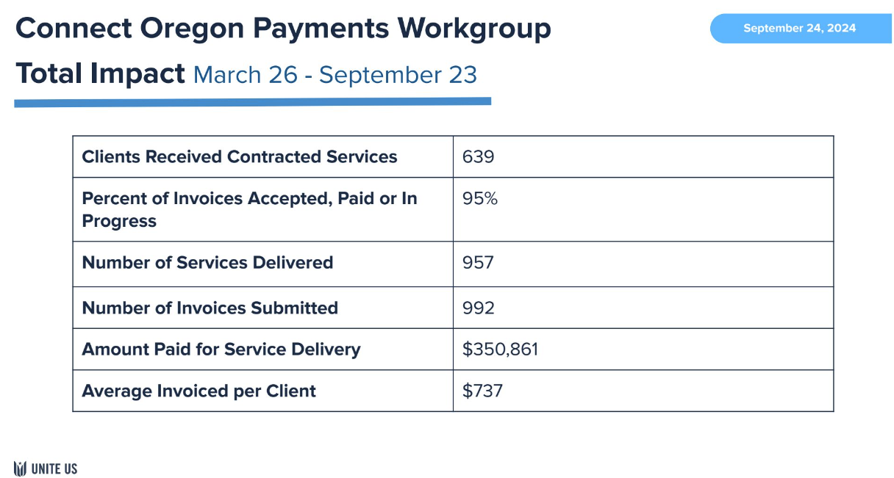
Where we go from here…
Continuing to generate data to see total HRSN service impact from partners using Connect Oregon
Preparing for Housing and Nutrition Go Live
Engaging more HRSN Service Providers in this work
More alignment with CCO metrics (SDOH & SHE)
Optimizing Connect Oregon & Payments functionality in partnership with Unite Us team
Notes:
LIZ to quickly wrap up on this slide

Slide 12
Questions? Thank you!
Maureen Seferovich, LCSW (she/her)
Program Manager- Health Systems Integration
Health Share of Oregon
seferovichm@healthshareoregon.org
Leslie Neugebauer OTR/L, MPH (she/her)
Vice President of Community Health, Social Needs, and Health Equity
PacificSource
Leslie.Neugebauer@pacificsource.com
Cara Kangas, CRS-DC (she/her)
Director of Partnerships
211info
cara.kangas@211info.org
Jennifer Gustafson
Director, Community Engagement
AllCare Health
Jennifer.Gustafson@allcarehealth.com
Liz Whitworth, MPH (she/her)
Managing Director
Oregon Health Leadership Council (OHLC)
liz@ohlc.org
Notes:
LIZ to close panel

