Slide 1
Health Councils: Lessons Learned from Community-Driven Governance & Investment
CCO Oregon Conference
October 2, 2024

Slide 2


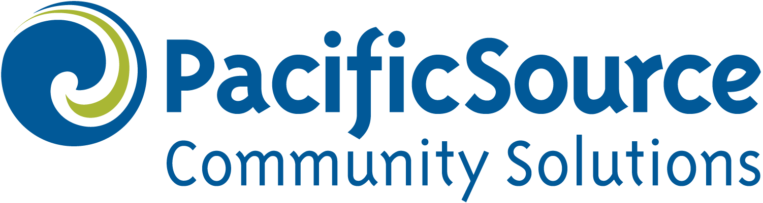
Panelists
Zaira Flores Marin (she/her), Marion-Polk CCO Director, PacificSource Community Solutions
Justin Hopkins (he/him), Executive Director, Willamette Health Council
Jeremy Gordon (he/him), Commissioner Polk County
Amy Houghtaling (she/her), City Council President Falls City

Slide 3
What We Will Cover Today
PacificSource Community Solutions (PCS)-Health Council CCO Joint Management Model
Willamette Health Council (WHC):
Highlight Recent Community Investment
Reflect on Promising Practices & Opportunities for Improvement
Polk County - Falls City Resource Center
Q&A

Slide 4
About PacificSource Community Solutions
Founded in 1933 in Lane County & headquartered in Springfield, Oregon
PacificSource serves over 350,000 OHP members
PacificSource Community Solutions (PCS) holds the CCO contract with the Oregon Health Authority (OHA) in four regions:
Central Oregon
Columbia Gorge
Marion-Polk Counties
Lane County

Slide 5
CCO Joint Management Model
PCS contracts with a local health council, which serves as local community governance body
Health councils are private, 501(c)(3) organizations
Board of Directors serve as the local CCO governing board

Slide 6
CCO Joint Management Model
The contract PCS holds with each health council outlines each organization's role and responsibilities for jointly managing the local CCO
Health councils are responsible for most of the CCO’s community-facing work, for example:
Running the Community Advisory Council
Carrying out the Community Health Assessment (CHA) and developing and implementing the Community Health Improvement Plan (CHIP)
Overseeing SDOH-E investments

Slide 7
CCO Joint Management Model
The contract PCS holds with each health council also indicates that PCS will:
Fund the operations of the health council at a certain percentage of their monthly capitation rate
Cap its net revenue
Any net revenue above the cap (“Shared Savings”) will be passed to the local health council for community reinvestment

Slide 8
CCO Joint Management Model
[hold for chart]

Slide 9
About the Willamette Health Council
Founded in 2019; began operations and hired our first Executive Director in 2020
Mission: Improve the health of the Marion-Polk community by governing our CCO, investing in our community, and fostering collaborative relationships
Vision: Optimal health and wellbeing for our community members
Values: Transparent, Collaborative, Equitable, Accountable, Adaptable, Strategic
Since 2020, we have invested more than $40 million in the Marion-Polk region
Many of our investments have aligned with the current Marion-Polk CHIP priorities of Behavioral Health & Housing

Slide 10
Community Investments – Shared Savings
2020 & 2021 were challenging financial years in large part due to the COVID-19 pandemic
2022 was the first year that the Marion-Polk CCO achieved Shared Savings ($12.7 million)
WHC and PCS engaged in a three-month long process to determine priorities and process for the distribution of Shared Savings funds within the Marion-Polk community
Those engaged included our Board of Directors, committees, and community stakeholders

Slide 11
Community Investments – Shared Savings

Slide 12
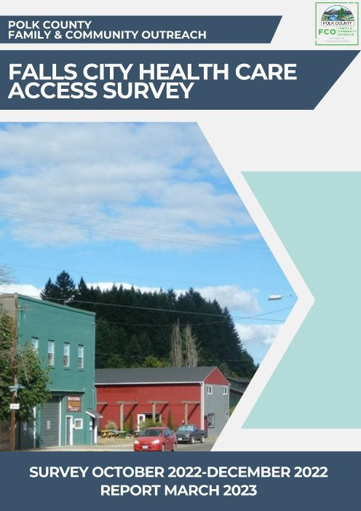


Community Investments – Spotlight on Falls City
It all started with incredible community will and a survey…
In 2022, WHC awarded a grant to Polk County Family & Community Outreach to conduct a community health survey in Falls City
Goal 1: Determine the family and community healthcare utilization needs/barriers
Goal 2: Identify potential avenues and necessary resources to meet identified needs (including viability of telehealth and mobile health)

Slide 13
Falls City Health Committee
Convened in April 2023
Partner organizations included:
Willamette Health Council
Polk County
Board of Commissioners
Family & Community Outreach
Behavioral Health
Public Health
City of Falls City
City Counselors
City Manager
Falls City Thrives
Falls City School District
Salem Health Hospitals & Clinics

Slide 14
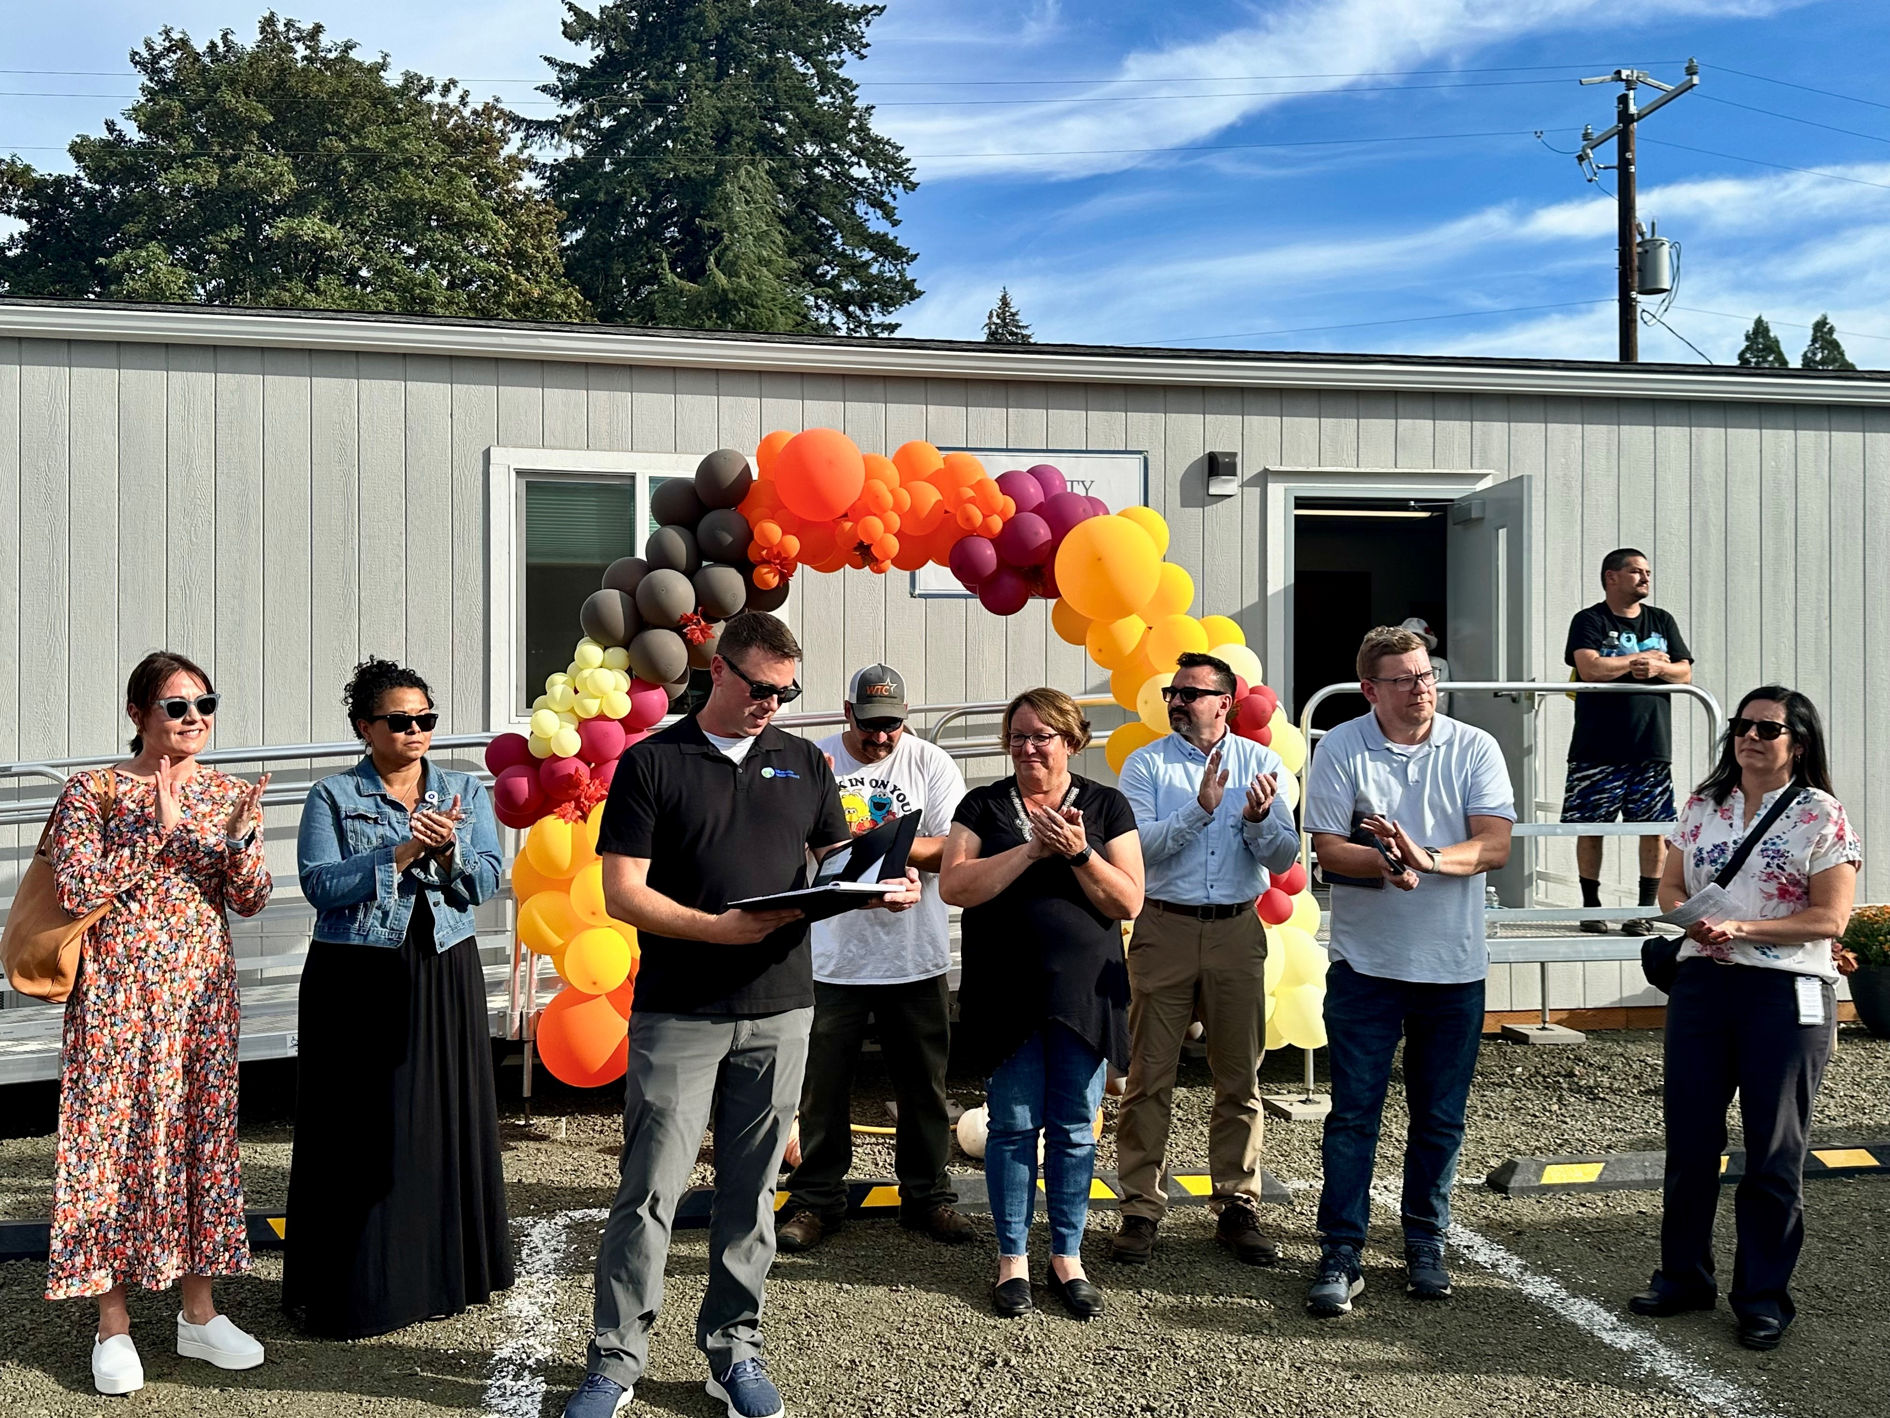
Falls City Resource Center
Land donated by the City of Falls City
Construction and initial operating costs funded from WHC Shared Savings ($700,000)
Managed by Polk County Family & Community Outreach
Designed to be a multi-purpose community space with various service providers spending time onsite

Slide 15
Promising Practices
Local oversight
Community engagement
Community reinvestment

Slide 16
Opportunities for Improvement
Roles & responsibilities
Local governance – What does it mean to govern?
Predictable funding for community reinvestment to support long term impact

Slide 17
Questions?

