Slide 1

Multifaceted Approach to Improved Oral Health Outcomes
Utilizing technology to improve the Quadruple Aim
Manu Chaudhry, MS, DDS
President
Capitol Dental Care
ChaudhryM@interdent.com
Tonya Clark
Executive Assistant
Capitol Dental Care
ClarkT@interdent.com

Slide 2
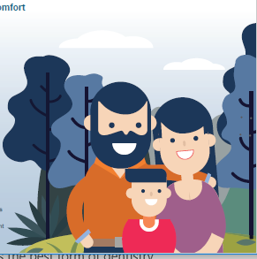
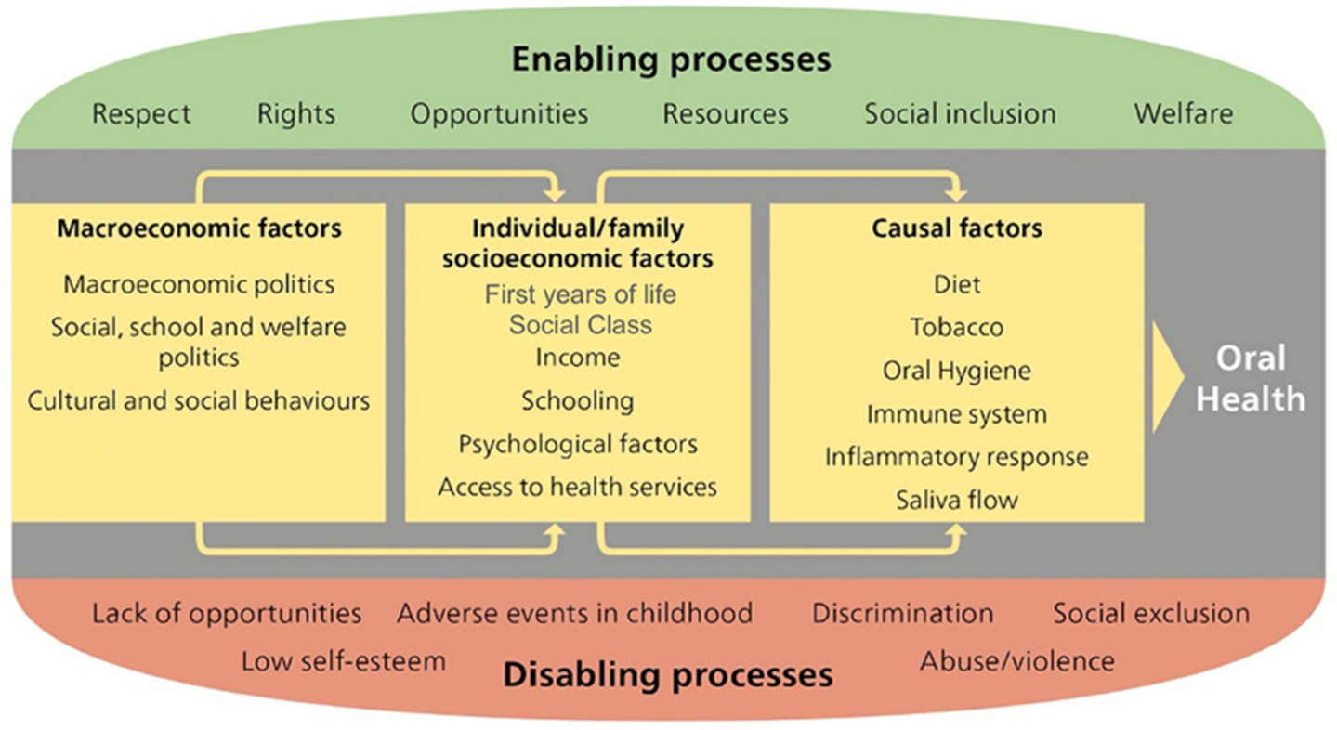

Capitol Dental Care
Our Mission is Why We’re Here!
We are committed to preventing dental disease and improving the oral and systemic health of all. We create access to quality care, use evidence-based methods and provide dental leadership within the communities we serve.
Our 5-Year Vision
Elevate humanity: Mountains beyond Mountains
2
Notes:
2

Slide 3
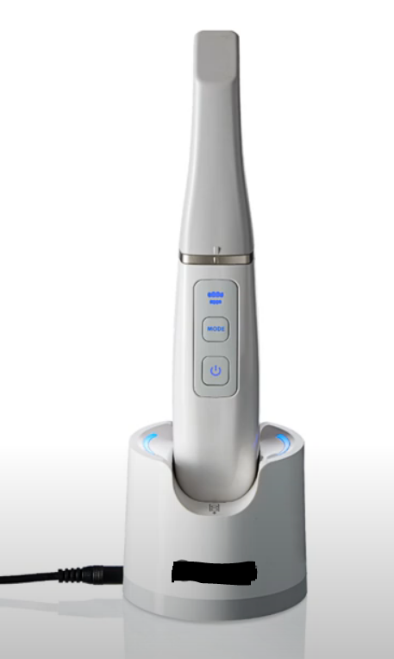
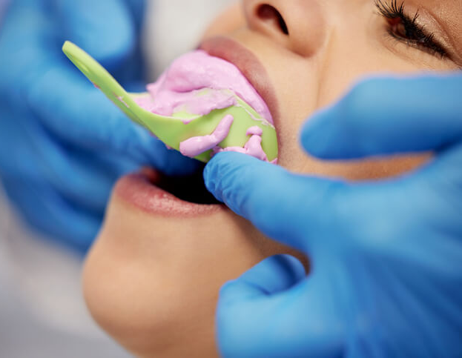
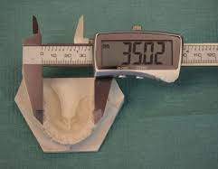
OHP Orthodontic Benefit
History
2021: CMS, EPSDT, HERC & State Dental Director
2023: Expanded Orthodontia benefit for Severe Handicapping Malocclusion
HLD score 26+, Assessing qualification, Denials & EPSDT review; OBD February 2023 regarding D8660
An unmatched future
Poor patient experiences, increased provider time for impressions, stone models and HLD measurements, poor member outcomes with high error rate with measurements
Improve patient experience, decrease time-consuming procedures, improve accuracy, ease admin burden
2021: RFPs OverJet®, Pearl ®, Videa Health® HLD measurements with Pano and photos
2022: Digital intraoral scanner technology, Validated HLD scoring, Health Information Exchange, 3D printer
Other uses: Removable dentures, wellness visualization tools, crowns, video capture
3
Notes:
3

Slide 4
Challenges & Next steps
Challenges
4 non-compatible software types (Imaging Scan Flow, Connect, AI tool, SprintRay 3D® printer) as barriers for Health Information Exchange
Imaging Scan Flow creates patient record, scans or imports a previous saved file, edits scan (i.e., remove fragments) and exports a cszx file. Used at point-of-care.
Connect (purpose built for process) sends STL file of “scan” to a “laboratory.” Transmits scan file to Admin office.
AI tool measures crowding from DCM file and calculates score.
SprintRay 3D Printer only prints STL file as 3D model.
Requires office to capture and save all three file types. Increased IT storage costs at office and DCO plan.
Extensive, validated Beta testing with double blind manual measurements
>150 unique cases of Posterior crossbite, arch form, anterior crowding, labio-lingual spread, pediatric dentition, ectopic erupted dentition
Next steps
Consolidate from 4 file types to 2 software types (AI tool & SprintRay 3D printer)
Contract with other Vendors to develop AI tool
Evaluate other AI vendors with latest technology and expand options to all providers
Population health reporting and outcome tracker
Improve scanner utilization & clinical process flow

Slide 5
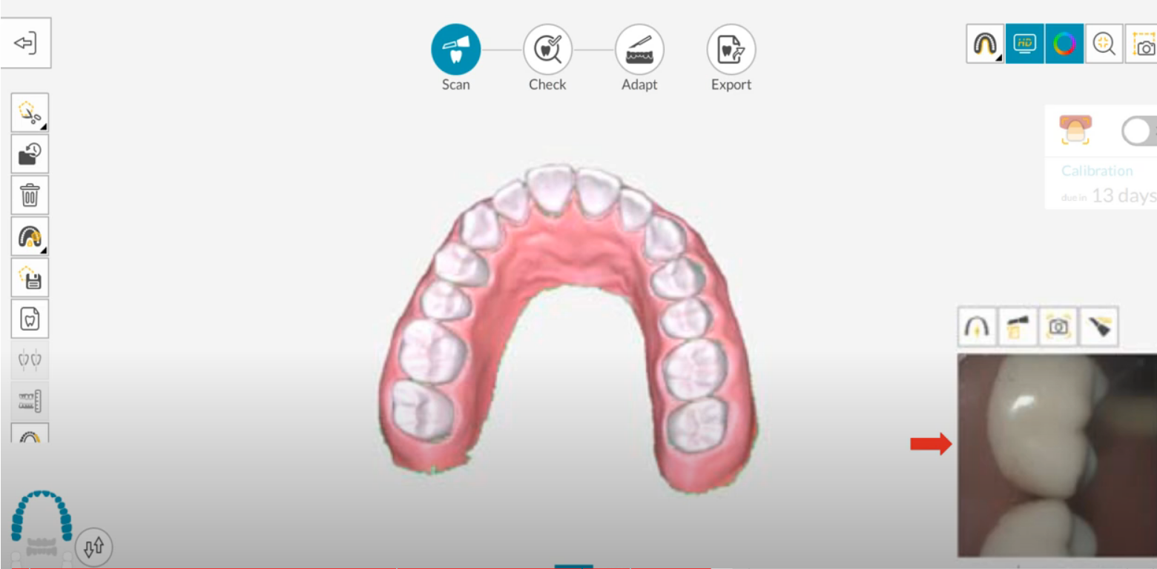
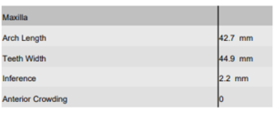
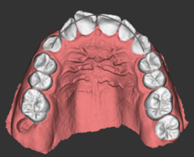
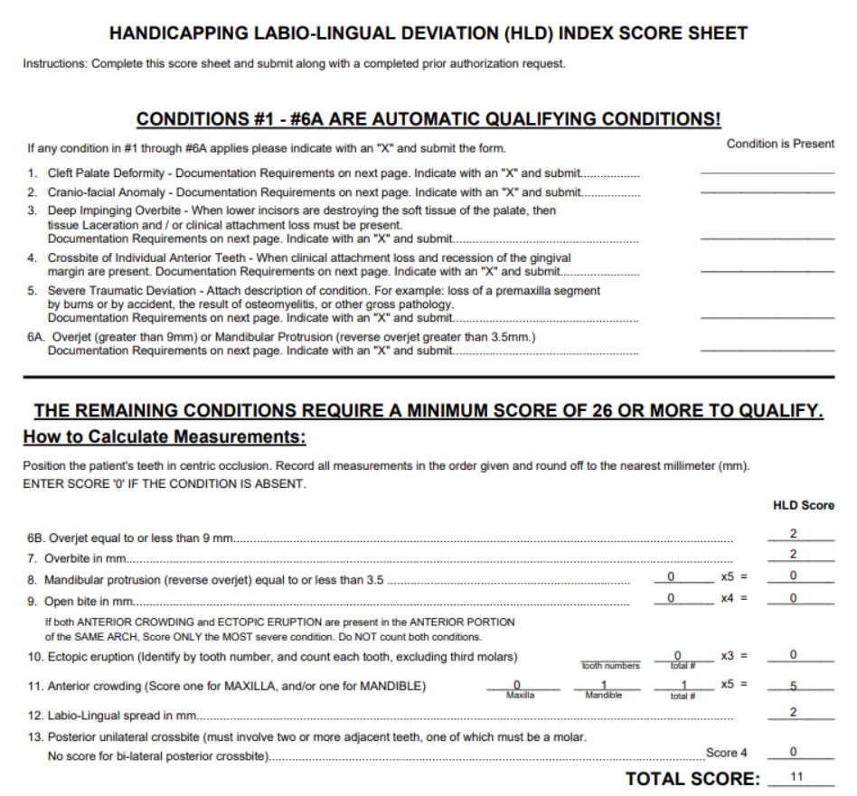
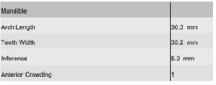
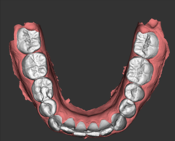
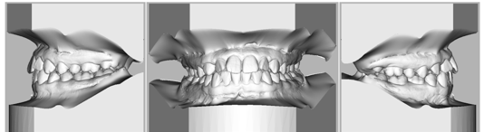
HLD scoring AI Tool
Visual Representation of Anterior Crowding

