Slide 1
A Perfect Storm:
Health Share’s
Ecosystem data analysis
Cat Livingston, MD, MPH
Andy Mendenhall, MD
October 2, 2024
CCO Oregon

Slide 2

Bio: Cat Livingston, MD, MPH
Cat Livingston, MD, MPH, is Medical Director of Health Share of Oregon, Oregon’s largest Coordinated Care Organization. She is boarded in Family Medicine as well as Preventive Medicine and serves as a primary care physician and researcher at Oregon Health & Science University as an Adjunct Associate Professor.
Prior to joining Health Share, she worked for the Health Evidence Review Commission (HERC) for a decade on evidence-based policy making for Oregon Health Plan’s unique Prioritized List. Her key areas of policy interest include evidence-based policy, substance use disorder, population health, metrics, and social determinants of health.

Slide 3

Bio: Andy Mendenhall, MD
Andy serves as the President and CEO of Central
City Concern. CCC is a 45 year-old system of care
and services providing Healthcare in a Healthcare
For the Homeless Federally Qualified Health Center,
Housing within ~2500 supportive and affordable
Housing units and Supportive Employment services.
In 2023 CCC provided services to more than 16,000
members of the Portland Metropolitan region.
Andy attended medical school at OHSU and
completed Family Medicine Residency in 2003. He is
double board certified as a Family Medicine and
Addiction Medicine specialist. He has previously
worked for the Hazelden-BettyFord Foundation,
Providence Medical Group and CleanSlate Treatment
Centers.

Slide 4

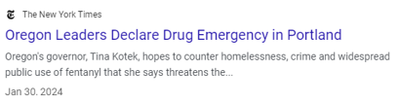

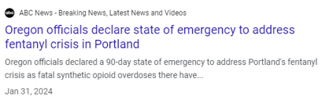
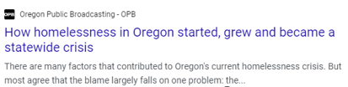

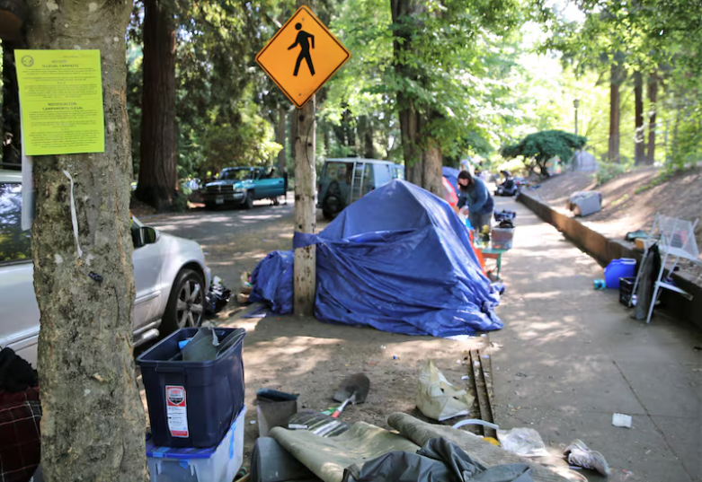
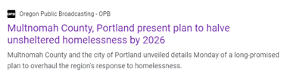
Intersecting crises
Substance Use Disorder (fentanyl, meth)
Homelessness crisis
Untreated mental health (psychosis)
Notes:
https://www.opb.org/article/2024/03/11/multnomah-county-portland-present-plan-to-halve-unsheltered-homelessness-by-2026/

Slide 5

Ecosystem Analysis
Data analysis looking at the nexus of substance use disorder, mental illness, and social determinants of health
Known cause of high utilization and (potentially preventable) high morbidity and mortality
Intersecting crises - New drugs, insufficient affordable housing, and the longstanding behavioral health capacity crisis are contributing to increased acuity
Hospitals also facing capacity crisis
Moral distress for care teams with discharging people with insufficient follow up care
➔unmet needs and system out of balance
Goals:
Develop structured data and frameworks to support a region-wide response
Understand the cohorts and acuity
Inform potential strategies to improve health outcomes
Will require breakdown of siloes

Slide 6
Ecosystem Cohort Data Analysis

Slide 7
Ecosystem Cohort
Cohort | Current Health Share members (as of 12/31/23) with [listed below] between Jan – Dec 2023 (from claims data)
1. Opioid Use Disorder (OUD) | 1+ OUD diagnosis
2. Stimulant Use Disorder | 1+ stimulant use disorder diagnosis
3. Psychosis | 1+ psychosis diagnosis
4. Substance associated overdose | 1+ substance associated overdose (unintentional only)
Final cohort | Any member in one or more of the cohorts 1-4

Slide 8
1 in 12 adult Health Share members (8%, n=26,068) are in the ecosystem cohort.
Data source: 2023 Health Share claims data, current as of April 2024

Slide 9
# and % of adult members in the ecosystem cohort.
The size of each cohort group ranges from 4% (Opioid Use Disorder) to less than 1% (unintentional substance associated overdose) of all Health Share adult members.
12465
11012
9656
1270
Data source: 2023 Health Share claims data, current as of April 2024

Slide 10
Race/ethnicity of Health Share members in the ecosystem cohort.
White, American Indian/Alaska Native, and Black/African/African American members are overrepresented in the ecosystem cohort.
*Race/ethnicity derived from a combination of REAL data and legacy data (when REAL is unavailable). The MENA category will be underrepresented because it was not a legacy field.
8% of all Health Share members are in the ecosystem cohort
Data source: 2023 Health Share claims data, current as of April 2024
Notes:
Race/ethnicity derived from a combination of REAL data and legacy data (when REAL is unavailable). The MENA category will be underrepresented because it was not a legacy field.

Slide 11
2023 Adult Inpatient Admissions.
Data source: 2023 Health Share claims data, current as of April 2024

Slide 12
Utilization Comparisons: 2023 Medical Inpatient Admissions per 1000 member months
5x higher than the average adult
7x higher than the average adult
12x higher than the average adult
Data source: 2023 Health Share claims data, current as of April 2024

Slide 13
Utilization Comparisons: 2023 Medical Inpatient Admissions per 1000 member months – Housing Insecurity Overlay
8-10x higher than the average adult
13x higher than the average adult
20x higher than the average adult
Data source: 2023 Health Share claims data, current as of April 2024
Notes:
**~8500 members flagged as houseless, housing instable, receiving the Health Share housing program, homeless according to long term support services data, inadequate housing, or other housing issue

Slide 14
Inpatient Top 10 – Primary Diagnosis
DX_Group | Any Cohort | Non-Cohort | Opioid Use | Psychosis | Stimulant and Psychosis | StimulantUse | Unintentional Overdose
Septicemia | 1 | 1 | 1 | 4 | 2 | 1 | 2
Schizophrenia spectrum and other psychotic disorders | 2 |  | 6 | 1 | 1 | 3 | 7
Hypertension with complications and secondary hypertension | 3 | 2 | 4 | 8 | 7 | 2 | 3
Depressive disorders | 4 | 10 | 7 | 3 | 3 | 5 | 10
Bipolar and related disorders | 5 |  |  | 2 | 4 | 8
Skin and subcutaneous tissue infections | 6 |  | 2 | 9 | 5 | 4 | 4
Diabetes mellitus with complication | 7 | 3 | 3 | 7 | 10 | 6 | 9
External cause codes: poisoning by drug | 8 |  | 5 | 6 | 6 | 7 | 1
Alcohol-related disorders | 9 | 4 | 8 | 5 | 8 | 10 | 8
Respiratory failure; insufficiency; arrest | 10 |  | 9 |  |  | 9 | 6
Cerebral infarction |  | 5
Pancreatic disorders (excluding diabetes) |  | 6
COVID-19 |  | 7
Acute myocardial infarction |  | 8
Obesity |  | 9
Complication of other surgical or medical care, injury, initial encounter |  |  | 10
Trauma- and stressor-related disorders |  |  |  | 10
Heart failure |  |  |  |  | 9 | 7 | 5
The reasons for inpatient admissions differ significantly between the ecosystem cohort and adult Health Share members not in the cohort – 5 of the most prevalent diagnoses for cohort members do not appear in the top 10 diagnoses for non-cohort members.
Data source: 2023 Health Share claims data, current as of April 2024

Slide 15
Synthesis
What does this analysis tell us?
Segmentation by these cohorts helps identify opportunities to improve care
Many of the individuals struggling with these conditions have accessed the system multiple times only to have it fail them
Many of these individuals do not access care in a single place, rely on a single provider, or engage in patterns that look like non-cohort members.
The Medicaid funding model is not optimized to get the right resources to the right places--particularly when it comes to addressing SDOH and significant BH needs.
The systems providing vital services and supports are not coordinated, including health, social services, and housing.
Notes:
* When a CCO's population is segmented with these criteria, we find a huge opportunity to improve care and support the provider network who is working with them every day.
* Many of the individuals struggling with these conditions are well-known to our systems--they're engaged in care, have access to providers
* Many of these individuals do not access care in a single place, rely on a single provider, or engage in patterns that look like non-cohort members.
* The Medicaid funding model is not optimized to get the right resources to the right places--particularly when it comes to addressing SDOH and significant BH needs.
* The systems providing vital services and supports are not coordinated, including health, social services, and housing. Organizations that try to combine these service offerings are struggling greatly.

Slide 16

Health Share’s Board
Question: How can we optimize Health Share's network to better meet the needs of these individuals and the systems designed to support them?

Slide 17
Health Share Ecosystem Workgroups
Workstream | Scope | Q1 and Q2 Deliverables 2024
Clinical Model (ie. Programs) | Develop population stratification model to identify and respond to segmented clinical needs and meet specific needs of racial/ethnic groups overrepresented in segments. | Refine clinical data priorities Assess existing models and where to scale Develop intervention(s) draft Identify model and support needed for implementation launch Engagement with model development with services outside health (prioritizing housing, corrections)
Care Management Strategy (ie. Systems) | Determine how population health management should be organized across delivery system discharge, PH and BH health plan care management, and housing providers. | Assess existing care management structure; define new options Develop mechanisms for engagement of County housing teams Prototype proactive integrated case review/conferencing to learn needs/gaps Identify appropriate Care Management Platform (and/or improvements needed to existing platform?) Develop integrated care coordination strategy (including housing, mobile crisis, etc.)
Risk Model and Outcomes Workgroup (ie Financial Model) | Finalize outcome metrics, incorporating use of an equity lens and develop staged financial model to support clinical model of care. | Kick off group! Explore national models for this type of arrangement Finalize operating definition of population (in consultation with clinical group) Develop simple model requirements to begin Develop draft of outcomes metrics Assess risk model options Complete recommendation on risk sharing models Develop ongoing monitoring reporting requirements
Notes:
This analysis led us to develop three workgroups (identify best clinical practices for this population, identify optimal care coordination including with social supports such as housing, and develop a financing/benefit management plan that supports a better way to ensure better outcomes).

Slide 18
Ecosystem Care Model Settings
Maternity
Emergency Department
Inpatient Medicine
Outpatient
Interstitial
Street Medicine
Post discharge transition
Housing Overlay
Notes:
Outpatient/ Community
Street Medicine
Post-discharge transition with residential support (RCP+, medical shelter beds, services delivered at temporary sites/motel)
Connected with appropriate care (wound care, BH, SUD care, OD prevention

Slide 19
Approach
Mini work groups
Representation across health plans
Review research
Identify current existing services
Develop consensus on core components of effective models
Develop recommendations for implementing/scaling/spreading
Questions for each model:
What are key outcomes?
How could we better impact equity and support culturally responsive care?
What is the role of care coordination?

Slide 20
Care Model Framework - Opportunities
We can improve health outcomes, better manage costs and support our provider workforce by developing a shared a system of care across the sub-populations of the High-Risk Behavioral Health Cohort
Care Coordination Model
Aligned care coordination for the cohort
Clinical Model
Scale 3 programs at highly utilized sites to better meet member needs:
Inpatient addiction consult service
Case Conferencing
ED MOUD program
Project Nurture
Pilot integrated clinical care from street to IP settings “Mobile Health Model”
Emerging opportunities

Slide 21
Conclusion
  System(s) not meeting needs of the ecosystem cohort
  Re-envisioning care
    No wrong door
    Clinical and non-clinical partnerships
    Understanding who leads coordination and navigation
    Call to action
  Re-envisioning financing
  Need investment up-front: will require multiple years
  Different payment models needed to offer flexibility
  Partnering across sectors is critical
  Aligning with housing sector with data, and meeting housing needs

Slide 22

Questions/comments
?

Slide 23
All Together, All for You.

Slide 24
Thank you

